Slide 1
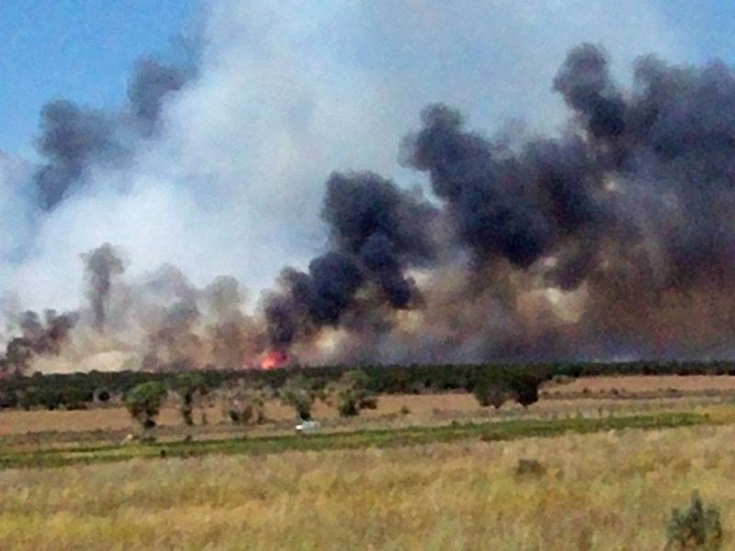
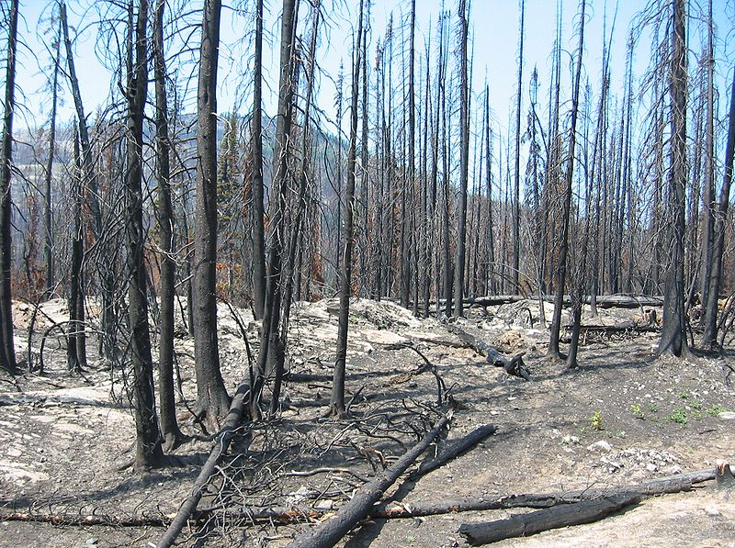
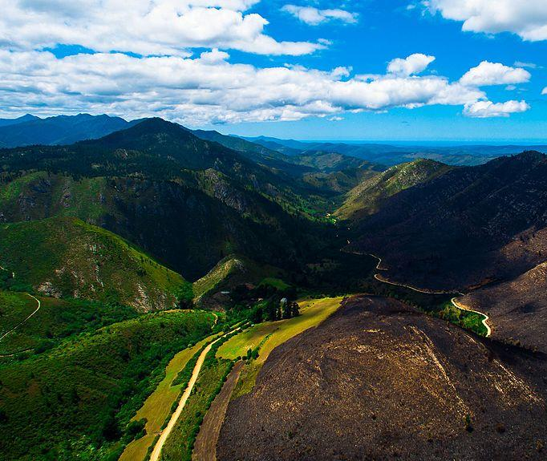
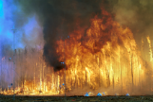
Data-Driven Wildfire Risk Prediction
Team 4
Megha Rajam Rao
Venkata Anil Kumar Thota Qiao Liu
Nandini Puppala
Prathusha Koouri

Slide 2
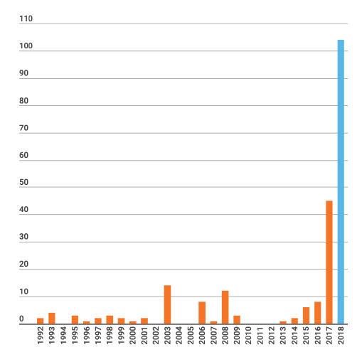
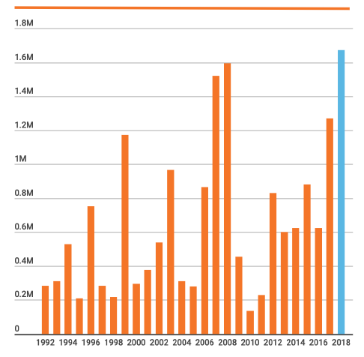
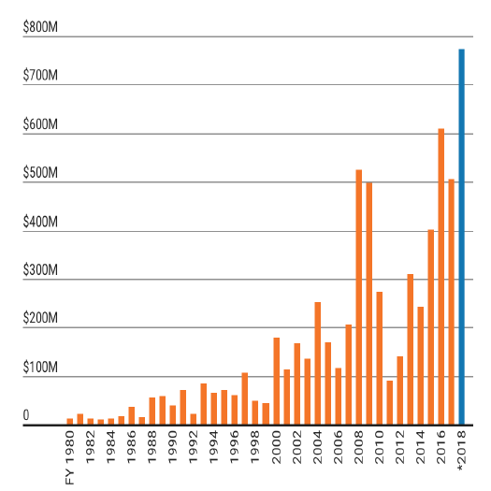
Fire statistics show the rapid increase of wildfire damage in California. Blue bar shows the largest numbers. The year 2018, deemed one of the worst years in California history, witnessed 7571 fires that burned across 1.6 million acres of land and claimed more than 100 lives.
Yearly death toll in California
Fire Statistics
Cost of Wildfires from the year 1980 to 2018
Yearly Estimation of acreage burned in California

Slide 3
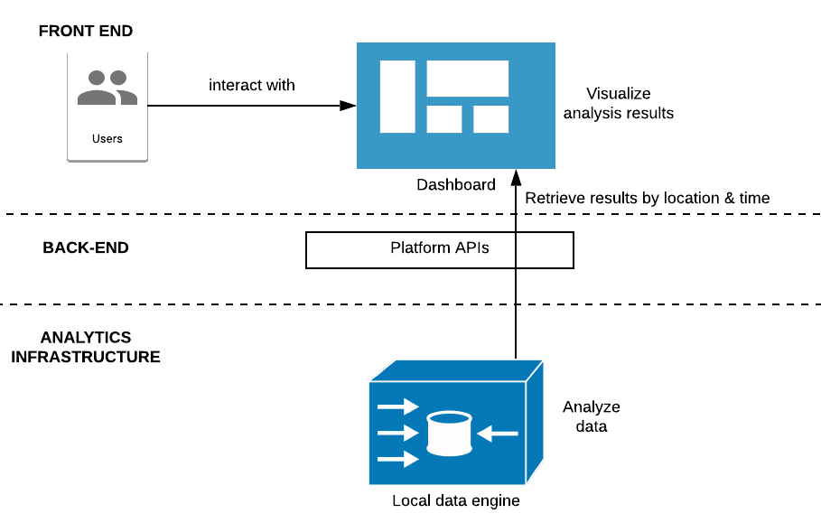
Project Overview
Objective: Build a model that improves accuracy for predicting wildfire risk in Northern California.
Purpose: Create a wildfire risk prediction system that would help concerned agencies such as Cal Fire.
Outcome: A ML model with augmented sensitivity that can predict local wildfire probability to a 92% accuracy. Also created an interface.

Slide 4
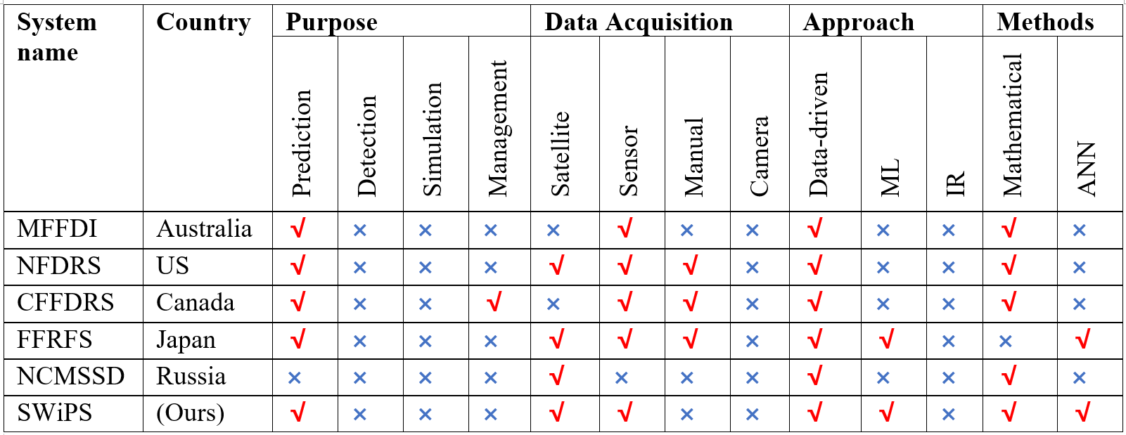
Comparison of different systems

Slide 5
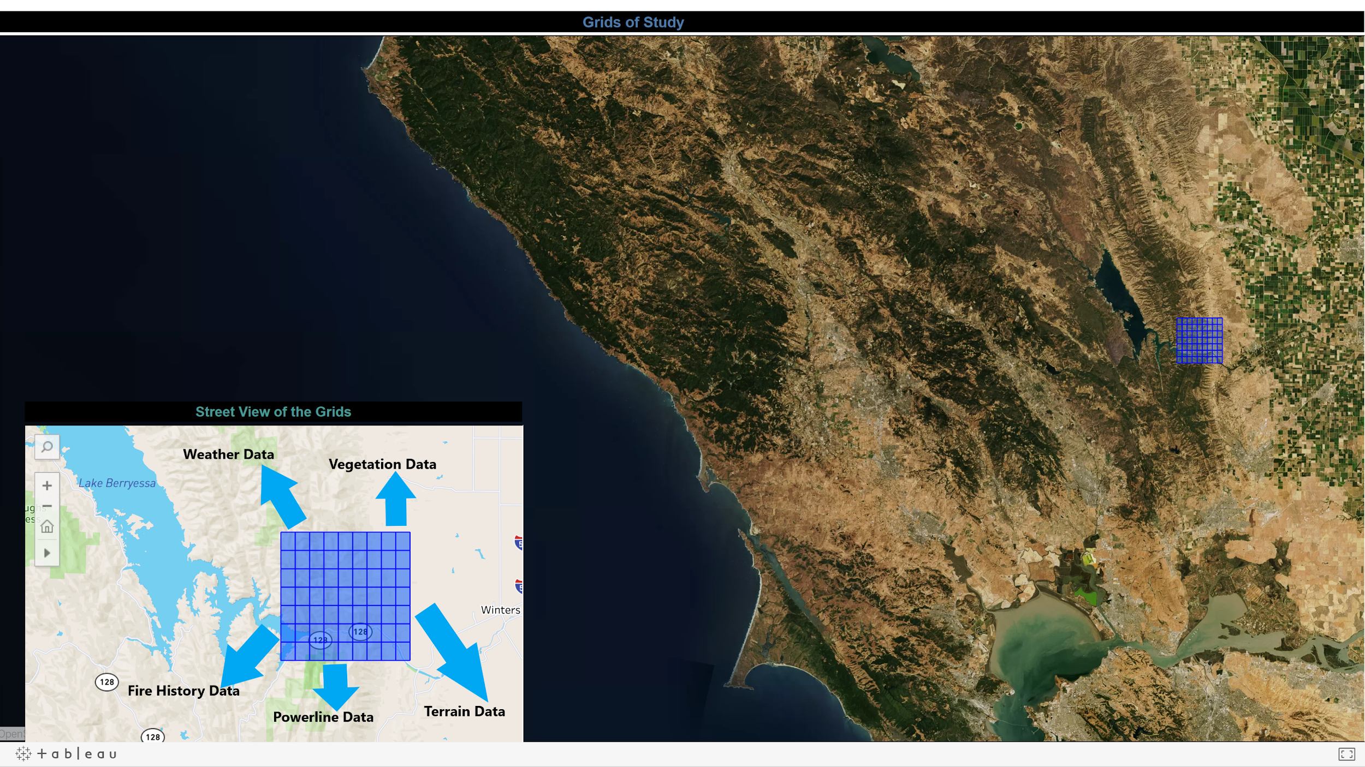
Study Area

Slide 6
Weather Data
Weather data from Local Climatology Data (LCD) is maintained by National Centers for Environmental Information (NCEI) which provides atmospheric and geospatial data across the United States.
Format – csv file
Date range - 01/01/2015 to 12/31/2018.
Frequency - Hourly
Source - https://www.ncdc.noaa.gov/cdo-web/datatools/lcd.
Size – 168 MB
Fields | Data Type | Description | Range | Unit
WBAN | Integer | WBAN is a five-digit number used for digital data storage and weather station identification. | (117, 94299) | NA
Latitude | Float | Latitude of the weather station | (32.81667, 41.78139) | Degree
Longitude | Float | Longitude of the weather station | (-115.57861, -124.23667) | Degree
Elevation | Float | Elevation of the weather station | (-17.7, 2172.6) | Meter
Date | Datetime | Time at which different weather parameters are captured. | (01/01/2016, 12/31/2018) | NA
Hourly DryBulb Temperature | Float | Dry Bulb Temperature of air at the weather station. | (-22.0, 115.0) | Fahrenheit
Hourly Relative Humidity | Float | Relative humidity at the weather station. | (1.0, 100.0) | Percentage
Hourly WindSpeed | Float | Wind speed at the station. | (0.0, 57.0) | Miles per Hour (mph)
Hourly Precipitation | Float | Precipitation at the station. | (0.0, 10.31) | Inches to Hundredths

Slide 7
Insert weather visualizations here

Slide 8
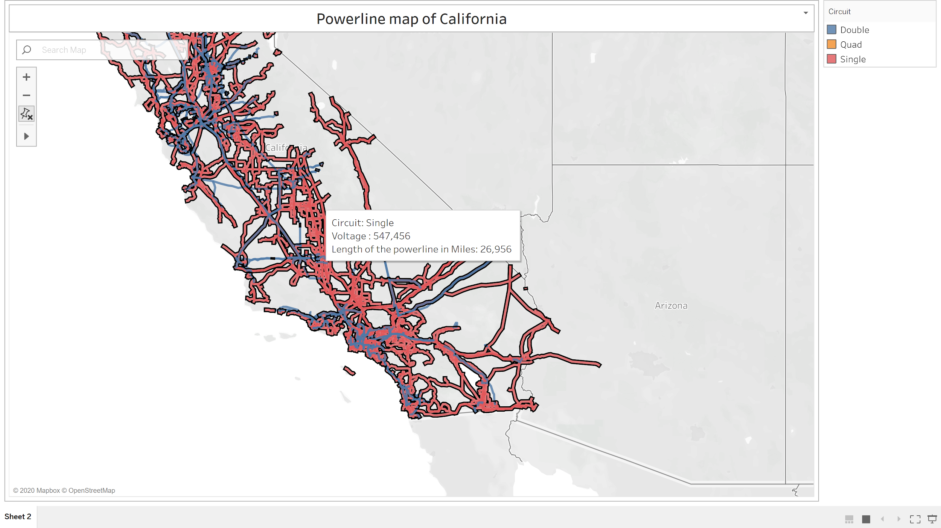
Powerline Data
Parameter | Description
kV | Voltage of the powerline
Owner | Owner of the powerline
Status | Whether the line is operating or not
Circuit | Type of circuit
Length (Mile) | Length of the line in miles
Length (Feet) | Length of the line in Feet
California Energy Commission created an Electric transmission line geospatial data layer to display the electric transmission grid in California.
Format – Shape file
Size - 58 KB
Source - https://www.energy.ca.gov/
Converted Shape file to data frame using QGIS tool

Slide 9
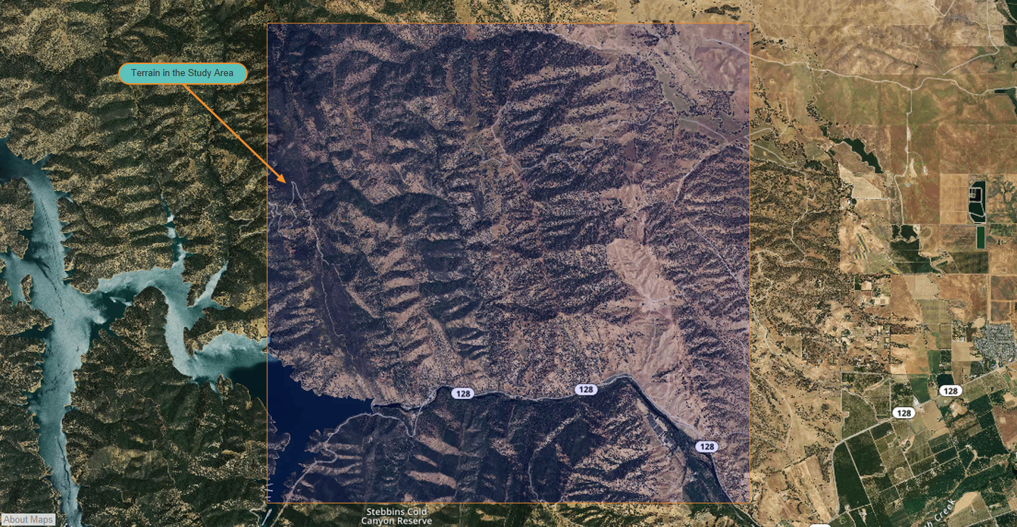
Terrain Data
United States Geological Survey provides topography information, which is available in the form of Digital Elevation Models (DEM).
Format - DEM file
Size – 1.6 GB
Calculated parameters from DEM using QGIS tool.
Source - https://www.usgs.gov/
Parameter | Description | Range | Unit
Slope | Slope of the terrain | (0, 90) | degree
Aspect | It is a compass direction that a slope face | (0, 360) | azimuth
Hill shade | Terrain surface with sun relative position. | (0,360) | azimuth

Slide 10
Fire History Data
Fire and Resource Assessment Program (FRAP) maintained by CAL Fire, United States Forest Service region, Bureau of Land Management and National park service.
Format - Shape file
Date range - 01/01/2015 to 12/31/2018.
Source - https://frap.fire.ca.gov/frap-projects/fire-perimeters/
Size – 80 KB
Column Name | Data Type | Description | Range | Unit
Year | Object | Year of Fire occurred. | (2016, 2018) | year
State | Object | State where the fire occurred | ‘CA’ | NA
Fire_Name | Object | Name of the fire | NA | NA
Alarm_Date | Datetime | Alarm date of the Fire. | (01/01/2016 ,12/31/2018) | NA
Cont_Date | Datetime | Containment date for fire. | (01/01/2016 ,12/31/2018) | NA
Cause | Integer | This column contains the Cause code which gives the reason for the fire. | (1,19) | NA
Report_Ac | Float | Area Consumed in the fire | (0, 25) | acre
GIS_Acres | Float | Area Calculated by GIS | (8.266294, 26.002495) | acre
C_Method | Float | Collection of data method coding | (1, 1) | NA
Objective | Float | Shows whether the fire is suppression or resource benefit | (1,1) | NA
Fire_Num | Object | Number assigned to the fire | (00001890 1716, 00000825) | NA
Shape_Length | Float | Length of the area burnt | (9.093210, 445282.444798) | meter
Shape_Area | Float | Area burnt | (6.130331,1.660030e+09) | Square meter
Geometry | Geometry | Shape of the area burnt | Within study area | degrees

Slide 11
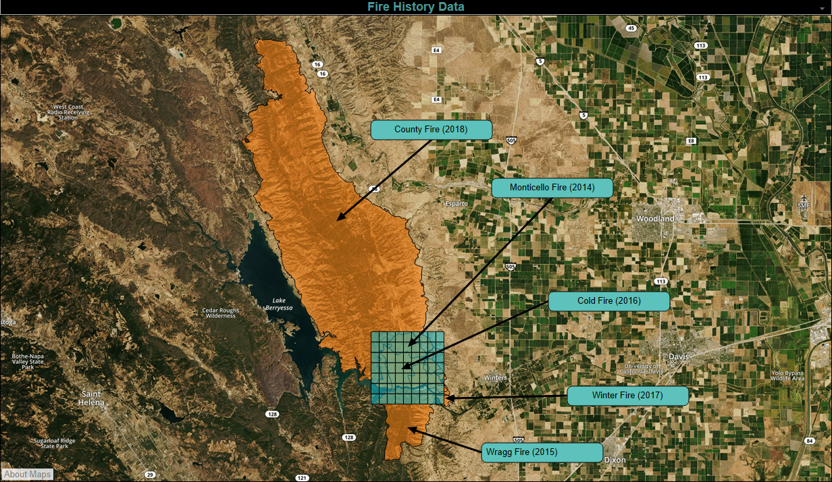
Fire History for Our Study Area

Slide 12
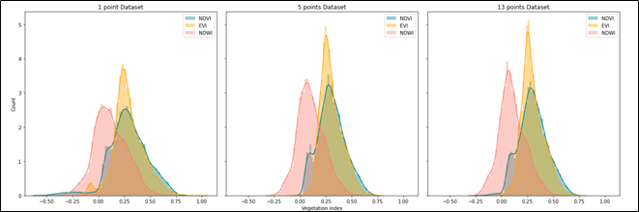
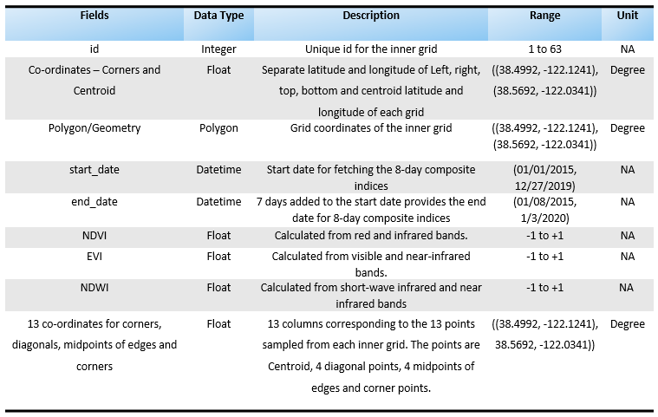
Vegetation Data
Landsat 8 remote-sensing satellite data was extracted from Google Earth Engine (GEE) using Python API.
Custom-made python functions were used for calculating indices from bands as well as fetching aggregate values.
Aggregates were consistent and reliable as they were pre-processed and devoid of atmospheric hindrances.
Size - 16 MB (final dataset)
Dimension - 226044 rows x 8 columns
Frequency - 16 days (Landsat 8)
Spatial Accuracy - 15 to 30 metres
Date Range - 1st January,2014 to 3rd January, 2020
Notes:
30 m (multispectral) and 15 m (panchromatic)

Slide 13
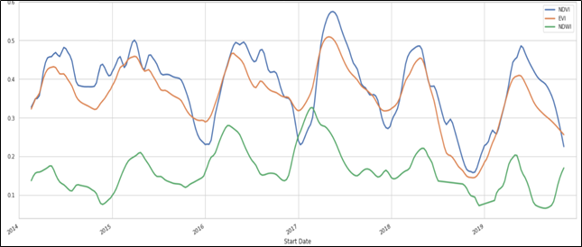
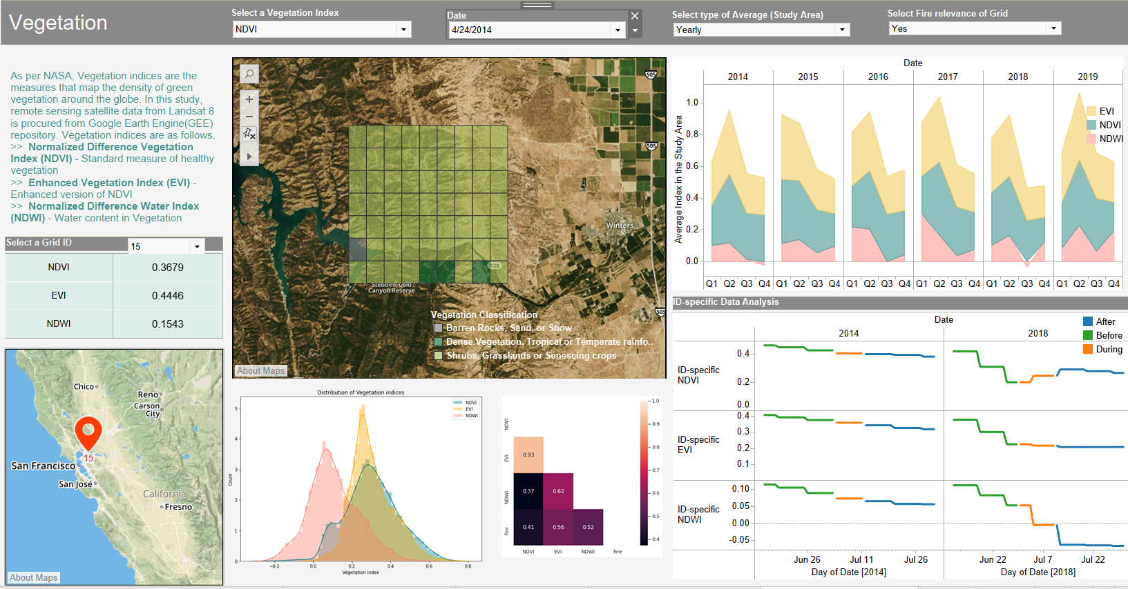
Vegetation indices are measures that map the density of green vegetation around the globe. Below are the chosen relevant indices.
Normalized Difference Vegetation Index (NDVI) - Standard measure of healthy vegetation
Enhanced Vegetation Index (EVI) - Enhanced version of NDVI
Normalized Difference Water Index (NDWI) - Water content in Vegetation
Data sampling - For each grid, a 1-point (Centroid only), 5-point (Centroid and corners) and 13-points dataset (Centroid, Corners, edges of midpoints and diagonals) were generated. The 13-point was chosen due to its completeness after a thorough statistical analysis.

Slide 14
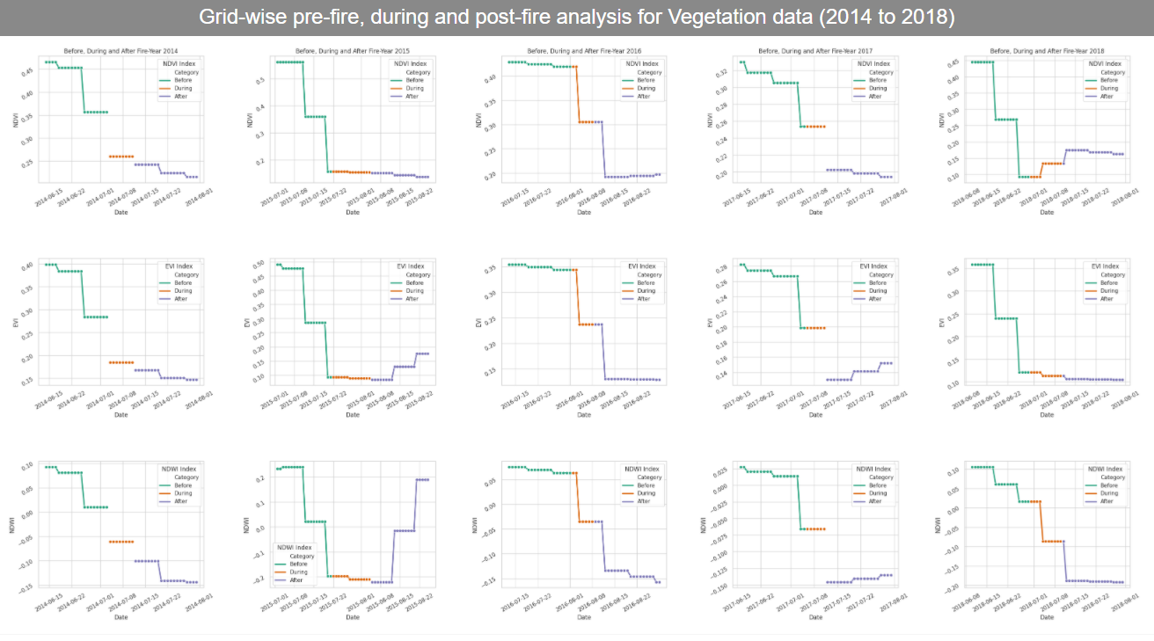

Slide 15
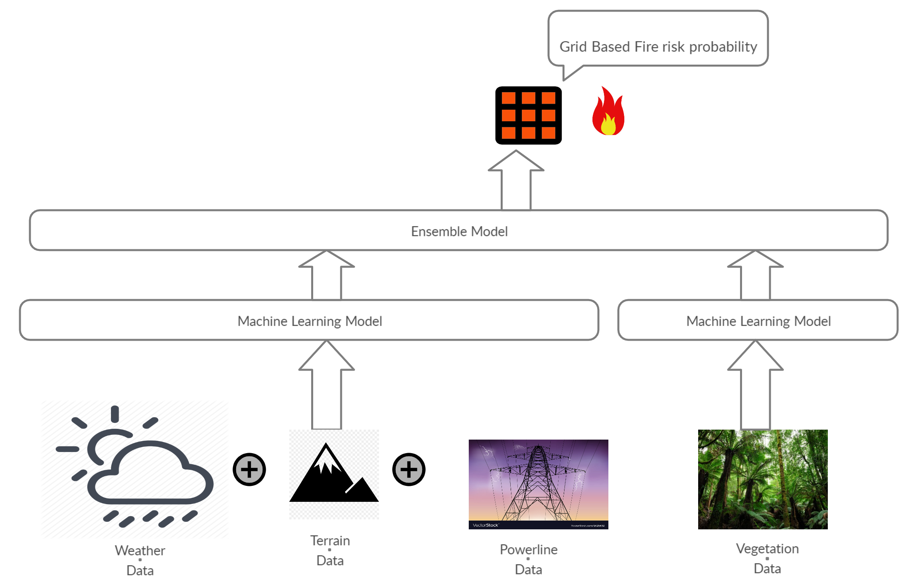
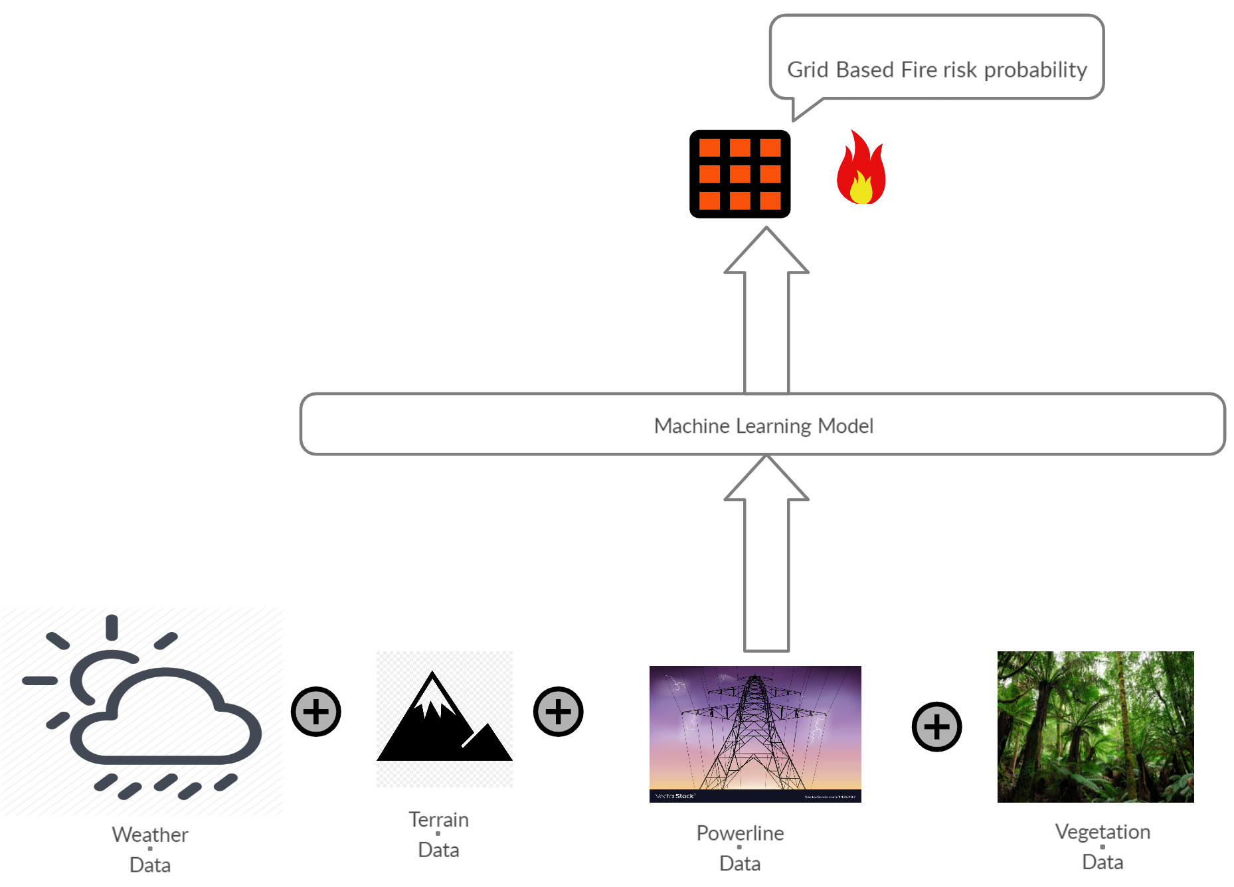
Proposed Solutions
Ensemble Model
Ensemble Model
Combined Model
Combined odel

Slide 16
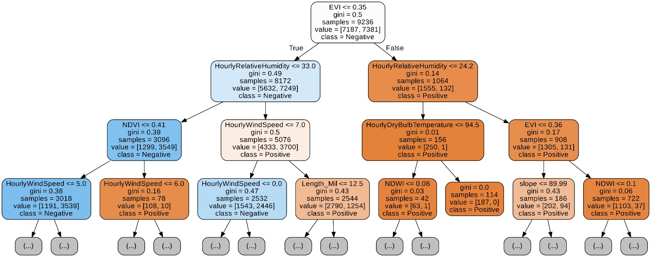
Model Experiments Random Forest Tree
Model | Accuracy | Hyper Parameters used
Random Forest | 92 | n_estimators = 200
Adaboost | 91.5 | n_estimators= 50, learning_rate = 1
Gradient Boosting trees | 90.5 | loss = deviance, n_estimators= 100
Weighted Decision Trees | 89.1 | criterion = gini, splitter = best
MLP | 86.1 | activation = Softmax, solver = adam
LSTM | 91.6 | Dropout = 0.2, activation = Softmax
Criteria for selecting the Machine Learning Algorithms for our Model:
Interpretability of Models
Algorithms with no assumptions about Data.
Considering Infrastructural resources at hand.
Based on Nature of our Data.

Slide 17
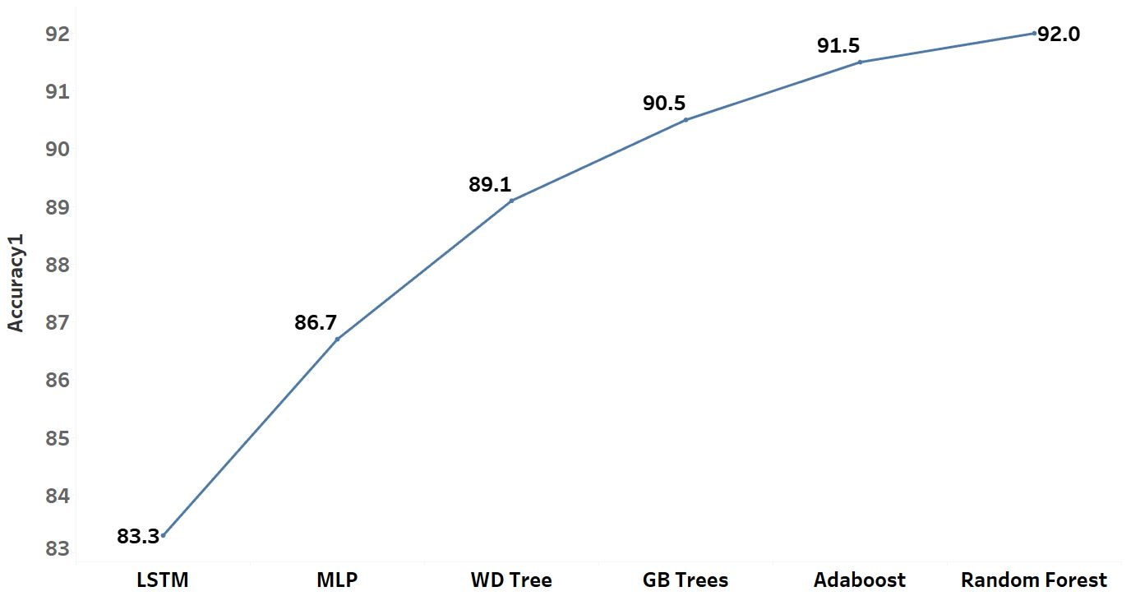
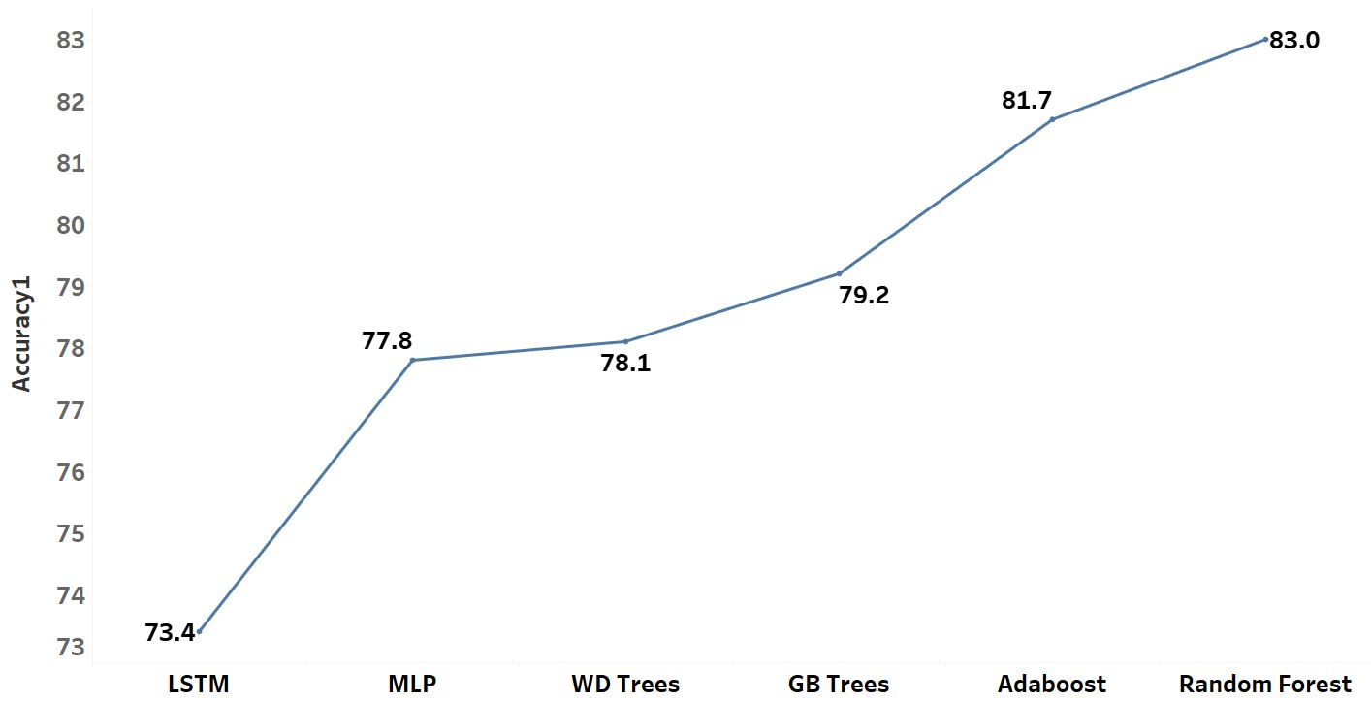
Accuracy Comparison for ML Models.
Combined Models
Ensemble Models

Slide 18
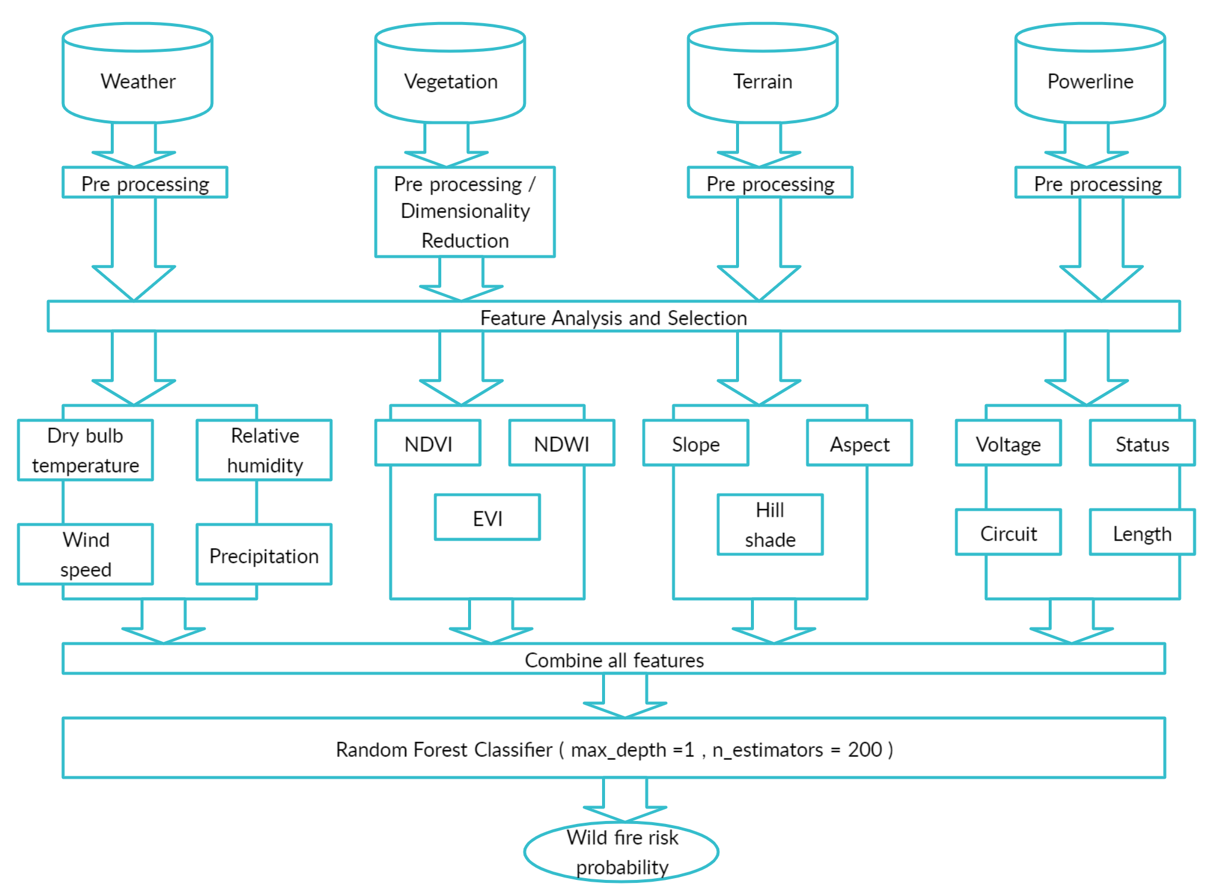
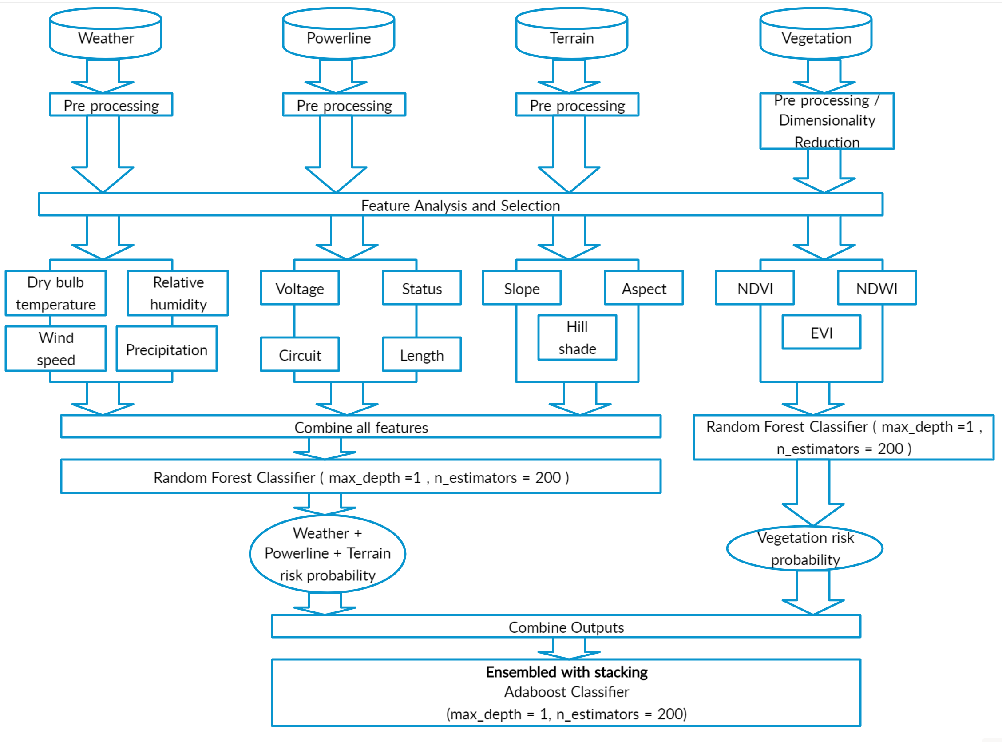
Combined Model Architecture
Ensemble Model Architecture

Slide 19
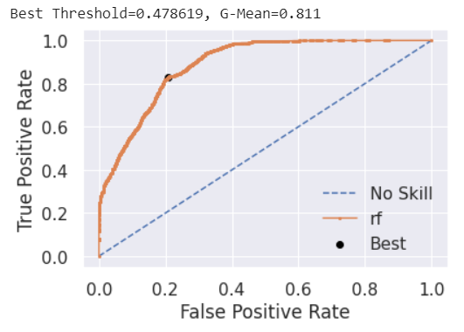
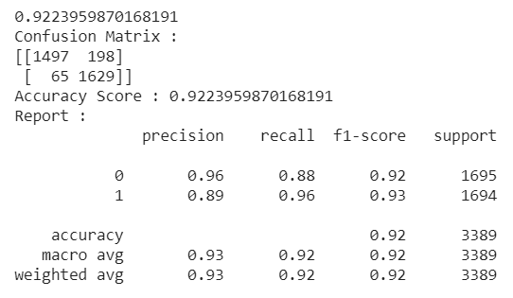
Tuning Threshold Values
Using the ROC Curve, we found the best threshold value for classification. Tuned the threshold values to reduce False Negatives and improve accuracy of model. The Images show the best threshold and model results with modified threshold value.
ROC Curve with Best threshold value
ROC Curve plots False positive rates vs True positive rates. Area under the curve is a true mark of model efficiency and its ability to classify.
Improved Model Results with Best Threshold

Slide 20
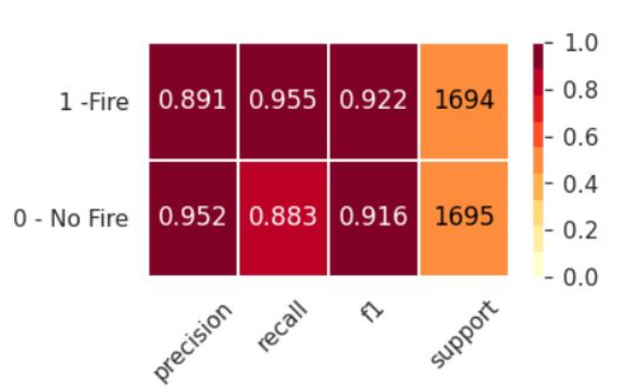
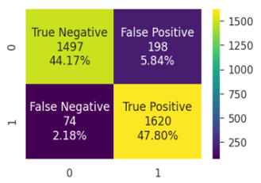
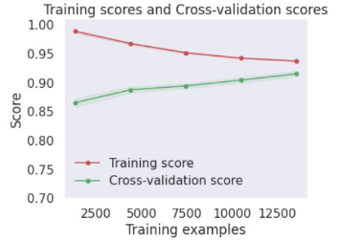
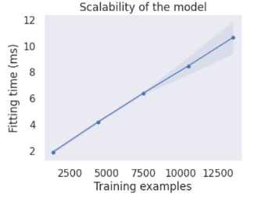
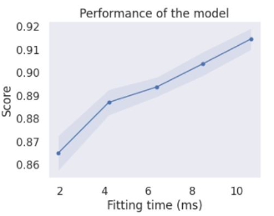
Evaluation Metrics for Random Forest (Combined Model with all Parameters)
Confusion matrix is a tabular representation of the number of true and false predictions.
Classification Report is based on confusion matrix numbers and shows the percentage for Precision, recall and F1 Score for all classes.
Learning curves include 3 graphs as shown below. They are helpful in evaluating the feasibility of the model.
Classification Report
Confusion Matrix

Slide 21

Conclusion
In this system, we model the precursor fire conditions with a combination strategy to mimic the real-time wildfire dynamics, leading to a robust data-driven fire prediction system named ‘Spartan Wildfire Prediction system (SWiPS)’.
It comprises a powerful backend algorithm connected to a front-end interface using Flask that displays the data analyses and results of our projects along with an add-on option for expert users to determine the fire probability at a specified location.
Datasets used: Vegetation, Weather, Terrain and Powerlines
Drawbacks: Need real-time data extraction for any random area, Model is area-specific, moderate temporal and spatial resolution of data.
Challenges: Complexity of parameters, lack of accessible and affordable data acquisition, pre-processing and modeling conundrums.

Slide 22
Lesson Learned
Recommendations
High resolution consistent data is expensive, unless government sponsored.
Ready availability of Satellite data in cloud catalogs.
Usage of Python Application programming interface (API) and plugins for data extraction.
Importance of feasibility check and null value imputation.
Visualization for isolation of anomalies.
Geographic and spatial data maps using QGIS and Tableau.
Sensor data quality assurance procedure for mechanical failure, data transformation failure and collection failure.
Hyperparameter tuning, data subsets and experimentation and myriad techniques for evaluation of your prediction results.
Impressive capability of Folium, Tableau (Desktop and Public) and Flask for interactive maps, dashboards and user interface generation.
Ideal successor to this undertaking is Fire behavior and spread studies
Study and formulate the Fuel and fire dynamics, with the help of experts to integrate newer accurate indices in our modelling system.
Inclusion of additional metrics, parameters and algorithms.
Access commercial data sources with exceptional spatial and temporal resolution if funding is available.
Consider parameters such as human activities, lightening, debris, campfire, smoking when data is published by concerned authorities.
Attempt to build a area-agnostic model, with wider applicability.
Data quality assurance standards and missing value imputation techniques can be juxtaposed and compared before modelling.
Integrate real-time data collection to the User interface for a robust data extraction mechanism.

Slide 23

DEMO

